Slide 1
The Ultimatum of July 23
The real crisis, the July Crisis, came not as a result of the assassination, but Austria-Hungary’s reaction to it. On July 23, it delivered an ultimatum that demanded the right to have its agents investigate the assassination on Serbian soil. All of Europe’s diplomats saw immediately that the ultimatum created a much larger crisis because it directly impacted the interests of several great powers. Even those diplomats who had dismissed the assassination of the Archduke as a possible cause for war saw that the ultimatum could well lead to war, and quickly. Armies recalled soldiers from leave and began preparing for war.

Slide 2
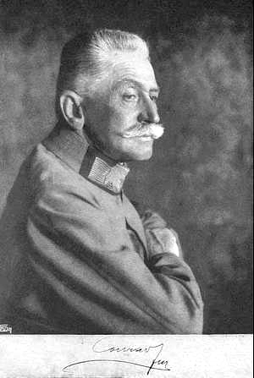
Austria-Hungary
Most members of the Austro-Hungarian elite wanted to react to the assassination with swift action. They saw themselves the victims of an act of state-sponsored terrorism from a Serbian government that had long been a problem for them. Many, like General Franz Conrad von Hötzendorff (right), saw the assassination as the pretext for crippling Serbian power.
http://upload.wikimedia.org/wikipedia/commons/a/a9/Hoetzendorf_Franz_Graf_conrad.jpg

Slide 3
Germany
The Germans gave the Austro-Hungarians their full support. Their diplomats concluded that the Russians would likely not support Serbia because Russia could not side with people who had killed a king. If the Russians did support Serbia, however, the Germans could then take their own steps toward war claiming that they were only acting defensively.
See the next slide for the text of Germany’s Blank Check to Austria: http://wwi.lib.byu.edu/index.php/The_'Blank_Check'

Slide 4
The “Blank Check”
Confidential - For Your Excellency's personal information and guidance
Berlin, 6 July 1914
The Austro-Hungarian Ambassador yesterday delivered to the Emperor a confidential personal letter from the Emperor Francis Joseph, which depicts the present situation from the Austro-Hungarian point of view, and describes the measures which Vienna has in view. A copy is now being forwarded to Your Excellency.
I replied to Count Szagyeny today on behalf of His Majesty that His Majesty sends his thanks to the Emperor Francis Joseph for his letter and would soon answer it personally.
In the meantime His Majesty desires to say that he is not blind to the danger which threatens Austria-Hungary and thus the Triple Alliance as a result of the Russian and Serbian Pan-Slavic agitation.
Even though His Majesty is known to feel no unqualified confidence in Bulgaria and her ruler, and naturally inclines more to ward our old ally Rumania and her Hohenzollern prince, yet he quite understands that the Emperor Francis Joseph, in view of the attitude of Rumania and of the danger of a new Balkan alliance aimed directly at the Danube Monarchy, is anxious to bring about an understanding between Bulgaria and the Triple alliance.
His Majesty will, further more, make an effort at Bucharest, according to the wishes of the Emperor Francis Joseph, to influence King Carol to the fulfilment of the duties of his alliance, to the renunciation of Serbia, and to the suppression of the Rumanian agitations directed against Austria-Hungary.
Finally, as far as concerns Serbia, His Majesty, of course, cannot interfere in the dispute now going on between Austria-Hungary and that country, as it is a matter not within his competence.
The Emperor Francis Joseph may, however, rest assured that His Majesty will faithfully stand by Austria-Hungary, as is required by the obligations of his alliance and of his ancient friendship.
Bethmann-Hollweg

Slide 5
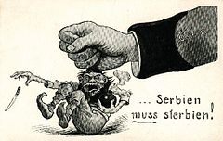
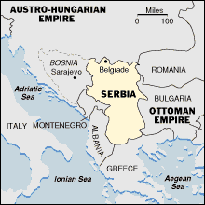
Austria-Hungary propaganda cartoon after the assassination of Archduke Ferdinand. The text reads “Serbia must die.”
http://en.wikipedia.org/wiki/Serbian_Campaign_(World_War_I)
http://www.pixelpress.org/bosnia/context/yugo1815.GIF.html
Notes:
On July 25, 1914, Serbia responded to the ultimatum. It did not accept all the provisions and three days later, on July 28th, Austria-Hungary declared war on Serbia and began to attack the capital, Belgrade. The declaration of war and subsequent attack affected many other countries in Europe due to the alliance system. Germany had agreed to support the Austria-Hungarian empire in the event of war. Russia, as an ally of Serbia, began to mobilize to help defend Serbia the day after the attacks on Belgrade began. After Germany learned of Russia’s mobilization, they threatened war unless Russia backed off. Russia refused, and on August 1st Germany declared war on Russia.

Slide 6
The Ultimatum
Austria-Hungary designed the ultimatum in a way that guaranteed that Serbia would reject it. They also gave Serbia just 48 hours to accept it in full or risk a war. By implementing that timetable, Austria-Hungary intentionally made it impossible for the great powers to intervene in the crisis.
Text of the ultimatum and the Serbian reply can be found at: http://www.firstworldwar.com/source/austrianultimatum.htm

Slide 7
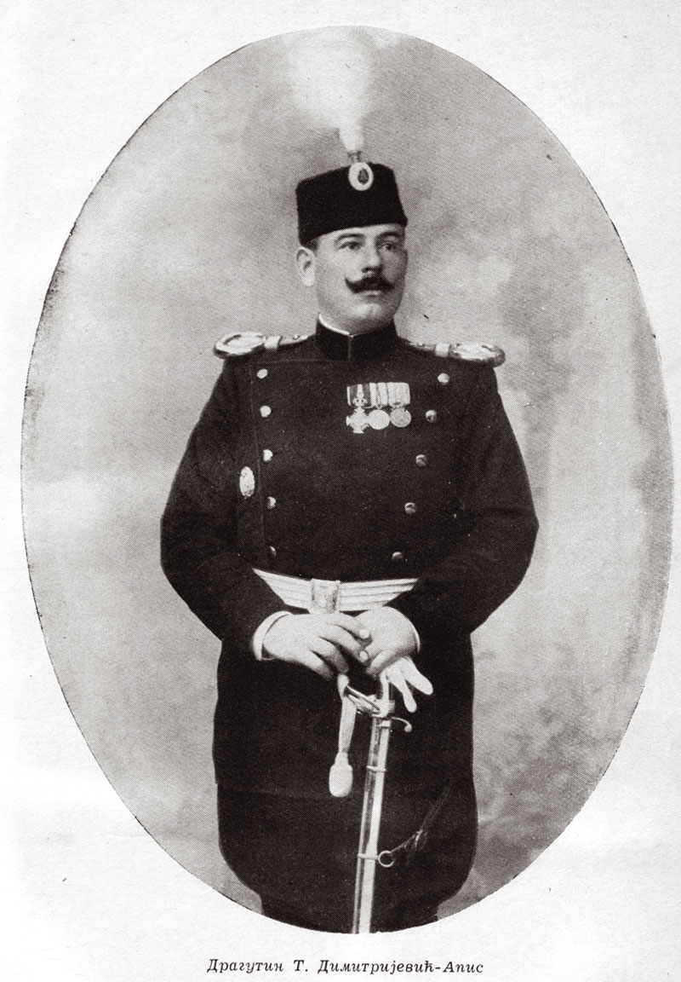
“It is clear from the statements and confessions of the criminal authors of the assassination of the twenty-eighth of June, that the murder at Sarajevo was conceived at Belgrade, that the murderers received the weapons and the bombs with which they were equipped from Serbian officers and officials who belonged to the Narodna Odbrana, and, finally, that the dispatch of the criminals and of their weapons to Bosnia was arranged and effected under the conduct of Serbian frontier authorities.”
Austro-Hungarian Ultimatum to Serbia, July 23, 1914
http://en.m.wikipedia.org/wiki/File:Dragutin_dimitrijevic_apis.jpg
http://wwi.lib.byu.edu/index.php/The_Austro-Hungarian_Ultimatum_to_Serbia_(English_translation)
Notes:
The month after the assassination saw a flurry of activity as Austria demanded justice for what they saw as state sponsored terrorism. Austrian officials believed the Serbian government was behind the attack. We now know that a Serbian Army office named Dragutin Dimitrijevic, along with two colleagues, trained the assassins and planned the attack. Tensions were already high between Austria-Hungary and Serbia over territorial disputes. The empire blamed the Serbian government not only for the assassination, but also for fostering unrest against Austria-Hungary in Bosnia. The unrest in Bosnia was a danger to the empire and after the assassination Austria-Hungary felt the only solution was an invasion of Serbia. The empire however was fearful of Russia, a close ally of Serbia and turned to it’s own ally Germany for advice. Kaiser Wilhelm felt that Russia was unprepared for war and would not intervene and urged Austria-Hungary to carry out an attack. On the chance that Russia did become involved, Wilhelm issued a “blank check” to the empire and promised it’s full support to the empire. For this reason, German is often seen as an aggressor who contributed to the start of the war.
On July 23rd, 1914, Austria sent Serbia an ultimatum. The ultimatum in part demanded that Serbia allow Austrian officials to investigate the assassination on Serbian soil. The document also blamed the Serbian government for allowing anti-Austro-Hungarian propaganda to be published, and for being tolerant of groups that were a threat to the empire. Serbia was given 48 hours to respond to the ultimatum or the empire would declare war. The short response time would prevent other European powers from pushing for a peaceful solution and allow Austria-Hungary to invade and try to dispel the unrest and gain additional territory to expand it’s empire.

Slide 8
Reactions
British Foreign Minister Sir Edward Grey saw the problem instantly. If Serbia rejected the ultimatum, as everyone knew it must, Austria-Hungary would likely invade, possibly setting off a chain reaction of alliance responses. Thus might countries with no connection to the crisis like France and Britain be dragged in, along with the full power of their empires.
Full text of Grey’s statement at http://www.firstworldwar.com/source/britishreaction.htm

Slide 9
Options
Diplomats worked feverishly to try to stop a war that looked more and more likely. They proposed arbitration, by which a great power would hear both sides and then decide. Others called for the great powers to state that they would not get involved, thus keeping any war isolated to Austria-Hungary and Serbia. The quick deadline in the ultimatum made these options unlikely.
Kaiser’s reaction to the July Crisis:
http://www.firstworldwar.com/source/julycrisis.htm

Slide 10
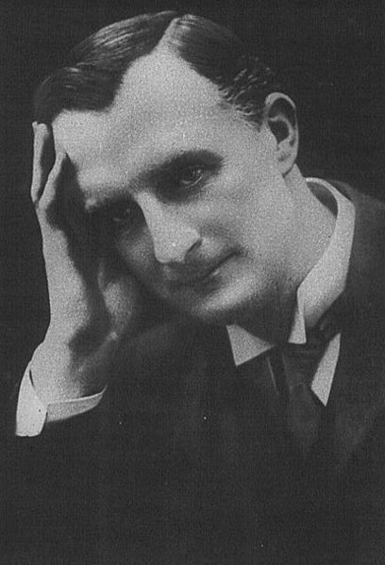
War?
With war increasingly a possibility, the great powers began to get ready. At this stage they were still mostly thinking of a local Balkan war, not a wider continental war. Still, they saw a duty to protect themselves and be ready for anything that might happen. By late July, however, more and more people saw how the circumstances of 1914 might turn a small diplomatic crisis into the largest war the world had yet known.
“The lamps are going out all over Europe, we shall not see them lit again in our life-time”
- Viscount Grey of Fallodon, "Twenty-Five Years 1892-1916" (New York, 1925), 20.
http://upload.wikimedia.org/wikipedia/commons/thumb/e/e5/Ed_Grey.jpg/408px-Ed_Grey.jpg

Slide 11
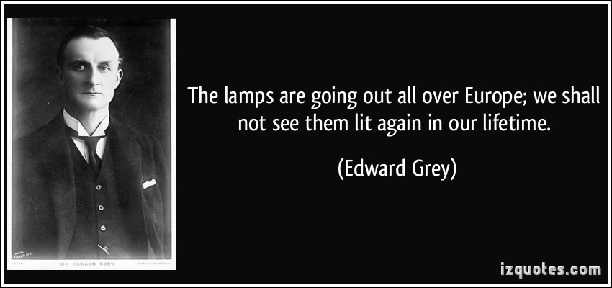
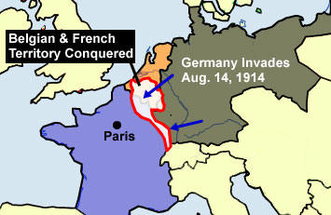
http://www.worldology.com/Europe/world_war_1.htm
http://izquotes.com/quote/75753
Notes:
German troops also moved towards Luxembourg and neutral Belgium. France, an ally of Russia, began to mobilize it’s troops on August 2nd in case of attack. On August 3rd, Germany declared war on France and invaded Belgium. That same day, Great Britain ordered Germany to withdraw from Belgium. When the Germans did not comply, Britain declared war on Germany on August 4th.

Slide 12
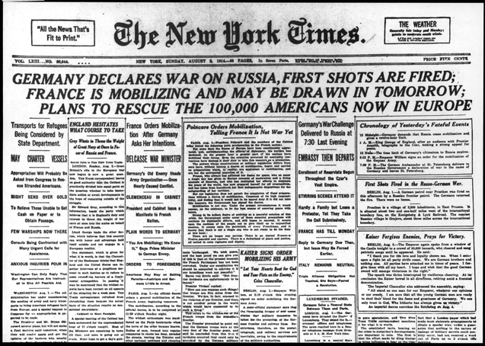
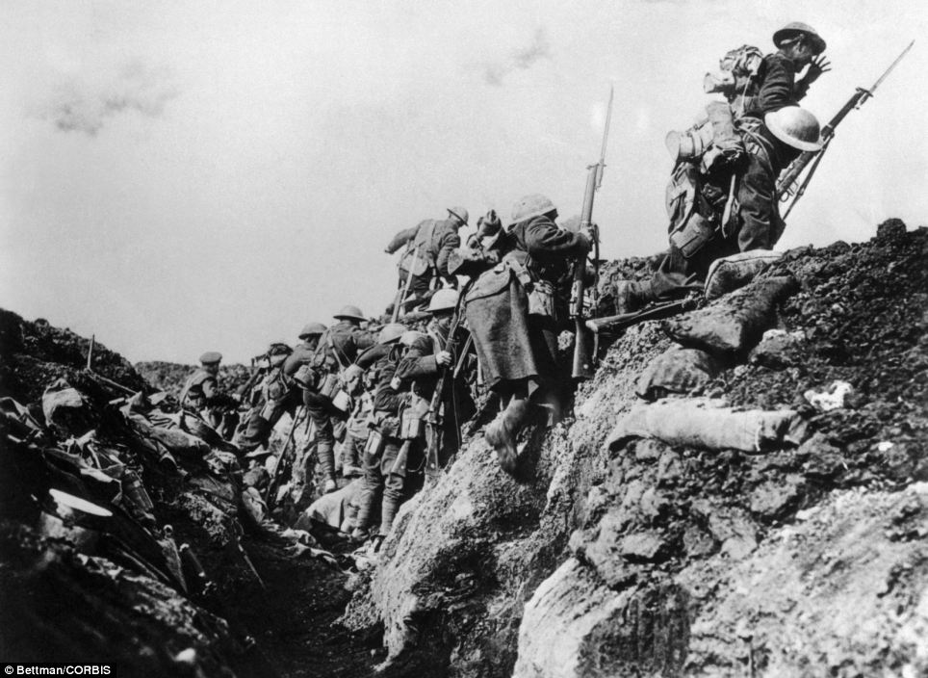
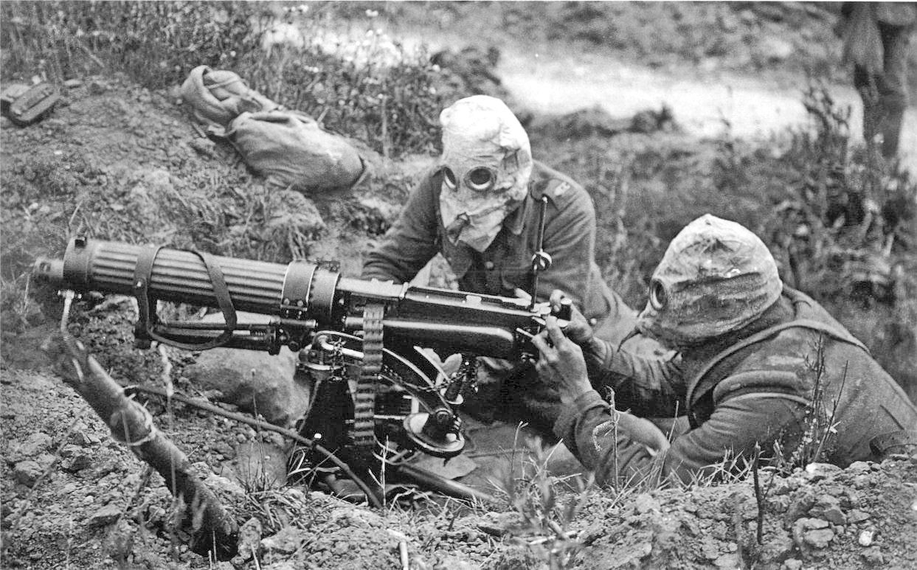
http://collections.yadvashem.org/photosarchive/en-us/5749732_6839.html
http://www.dailymail.co.uk/news/article-2226235/Historian-Andrew-Robertshaw-builds-60ft-long-First-World-War-TRENCH-Surrey-garden-highlight-plight-frontline-Tommies.html
http://en.wikipedia.org/wiki/Chemical_weapons_in_World_War_I
Notes:
Since 1914, many people generally consider the assassination of Franz Ferdinand by Gavrilo Princip to be the catalyst that set off World War I. Were there other causes of World War I? What were the short and long term causes? Why have people associated the death of Ferdinand with the start of the war? Did his death actually cause anything?

